Slide 1


Clinical Network Model –
Sample Use Cases

Slide 2
Background
Platform Concept Discussion
A platform that can help doing monitoring of 200+ sites by a Large CRO/Pharma.
This Presentation
Discuss the Platform
Sample use cases of the current version

Slide 3



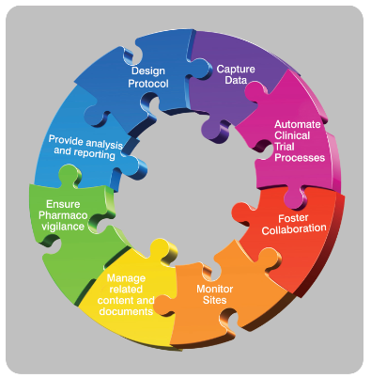
Clinical Trial Network Model
Unified Experience Platform -- Information Flow of Documents, Workflows, Data Analytics
Global Pharma
Global CROs
Large Sites
Regional CROs
Regional Sites
Sub-sites
Sub-sites
Investigators
Investigators
Investigators
Subjects
Subjects
Subjects
Small CROs/SMOs
Regional Pharma
Investigators
Subjects
Small Sites
Regulatory Authorities
Medical Reps
Clinical Labs

Slide 4
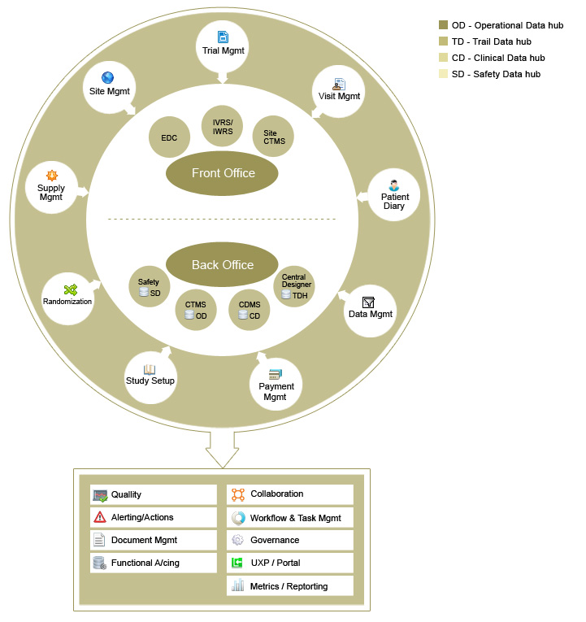
The Concept
Concept of Central Monitoring
Central Applications
Transactions (few examples)
Several interactions/Collaborations between Central and Sites
Site Applications
Masters – Study
Feasibility
Request collaboration
Documents
Risk Management
CRA visit scheduling

Slide 5




Trial Life Cycle Processes
Study Startup
Study Conduct
Study Closeout
Study Planning & Tracking
Clinical Budgets
Training
Inv Payments
Patient Stipend Payment
Vendor Payments
QA & Audits
Study Reports
Site Activation
IP\CP Shipment
Site Closeout Visit
Approved Protocol
Complete CRF/eCRF
Project Contract
Recruit Patients
Schedule Visits
Conduct Procedures &Dispense IP
Query Resolution
Protocol Compliance
Safety Reporting
Database Lock
Maintain SMF
Site Feasibility & Selection
Statistical Analysis
Site Contract
Track Recruitment
Visit Tracking
IP Tracking
CRF Tracking
Compliance Tracking
AE/SAE Tracking
Query Tracking & Closure
Clinical Study Report
Reg Submission
Maintain TMF
Reg Submission
Data Management Plan
Site Initiation Visit
Monitoring Visits(SMV)
SDV
Reg Doc review
Site Training
Database Design
Monitoring Visit Report
Clinical Project Plan
Site Issues Follow up

Slide 6
Integration Touch Points
Site details
Delivery addresses
Patient number ranges
Site CTMS
Study timeline
Central CTMS
Study Startup
Ethics approval
Regulatory approval
Regulatory Approval
Project Planning Data
Feasibility
Financial tracking data
Site Activation
Patient tracking data
Study Conduct
Supplies tracking data
Study Conduct
Monitoring Visits
Risk/AE tracking data
Performance tracking data
Site de-activation
Site / study close

Slide 7
Initial use-cases
Scenario | Description
“Feasibility” | Central user will require data from sites Site user provides update info Central user then selects best fit Sites for given study
“TrialDef” | Central user should be able to define study and propagate the study mandate to all chosen sites Site users add study team and set roles
“TrialVisits” – Trial Visit Documents | Central user (PM) sets up the CPP and the visit plan Site users update visit plan System syncs up the flow of events and triggers alerts for workflow and deviations
“TrialDocs” – Trial Documents | Central user will choose study documents (TMF) and ensure site document are set up(SMF) Site users can update document libraries System syncs up flow of events and triggers alerts for workflow or deviations
“TrialRequests” – Trial Query Management System | Central user can ask and seek clarifications Site user can ask or update clarifications ( with attachments)
“TrialRisk” | Central user observes critical metrics and system alerts to understand risk and create mitigation steps.

Slide 8
1. Study and Sites Setup

Slide 9
Step 1.1: CRO Creates Trial and Syncs with Several Sites
Central Apps – CRO (C₁)
Field Apps – Site (S1)
Dashboard
Study
Visits
Docs
Query
v
Dashboard
Study
Visits
Docs
Query
Create Study
CPP
Protocol
Study Team
Training
View Study
CPP
Protocol
Study Team
Training
Study St Date End Date Sites
Study St Date End Date CRO
T-1 21-1 -12 25-6-13 S₁,S₂,..S_{n}
T-1 21-1 -12 25-6-13 C₁
T-2 21-3 -12 25-6-14 S₂, S₃..S_{n}
View Study
Create New Study
Add Sites
Publish Study
Study/TrialMaster
Published to all chosen Sites
S₁
S₂
S_{n}

Slide 10

Step 1.2: CRO Creates Project Plan and Syncs with Several Sites
Central Apps – CRO (C₁)
Field Apps – Site (S1)
Dashboard
Study
Visits
Docs
Query
vv
Dashboard
Study
Visits
Docs
Query
Create Study
CPP
Protocol
Study Team
Training
View Study
CPP
Protocol
Study Team
Training
Desc Version Doc Status
Review CPP
125FRT001_CPP v1.0 Approved
125FRT001_CPP v1.0 Final
Site Queries
Queries
S1 Site Activation Timeline Open
Site Activation Timeline Open
S2 Budget update Closed
Review CPP
CPP Queries
Create CPP
CPP Workflow
Publish CPP
Site can access relevant sections of CPP
S₁
S₂
S_{n}

Slide 11

Step 1.3: CRO Creates Protocol and Syncs with Several Sites
Central Apps – CRO (C₁)
Field Apps – Site (S1)
Dashboard
Study
Visits
Docs
Query
v
Dashboard
Study
Visits
Docs
Query
Create Study
CPP
Protocol
Study Team
Training
View Study
CPP
Protocol
Study Team
Training
Rationale
Procedures
Visit Schedule
Review Protocol
Desc Version Doc Status
125FRT001_Protocol v1.0 Final
125FRT001_CPP v1.0 Approved
Queries
Site Queries
Lab Test Query Open
S1 Lab Tests Query Open
S2 Study Procedures Closed
Review Protocol
Protocol Queries
Protocol Setup
Protocol Workflow
Site Query Response
S₁
S₂
S_{n}

Slide 12
Step 1.4: CRO Team set up & Review Site Team
Central Apps – CRO (C₁)
Field Apps – Site (S1)
Dashboard
Study
Visits
Docs
Query
Dashboard
Study
Visits
Docs
Query
Create Study
CPP
Protocol
Study Team
Training
View Study
CPP
Protocol
Study Team
Training
Central Team
Role
Name
Duties
Investigator
Site Team Team details
CRC
S-1
S1_Team
S-2
S2_Team
Setup Central Team
Review Site Teams
Setup Site Team
Duty Delegation
Notify CRO
S₁
S₂
S_{n}

Slide 13
Step 1.5: CRO Conducts Initiation visits & Site Training
Central Apps – CRO (C₁)
Field Apps – Site (S1)
Dashboard
Study
Visits
Docs
Query
Dashboard
Study
Visits
Docs
Query
Create Study
CPP
Protocol
Study Team
Training
View Study
CPP
Protocol
Study Team
Training
Site Planned Date Status
Announcements
Training Docs
Protocol Training 10-03-2012
_{EDC Manual}
_{Operations Manual}
S-1 10-03-2012 Overdue
EDC Training 10-03-2012
S-2 05-03-2012 Completed
Initiate Sites
Conduct Site Training
Track Site Training
Training
Access Training doc
S₁
S₂
S_{n}

Slide 14
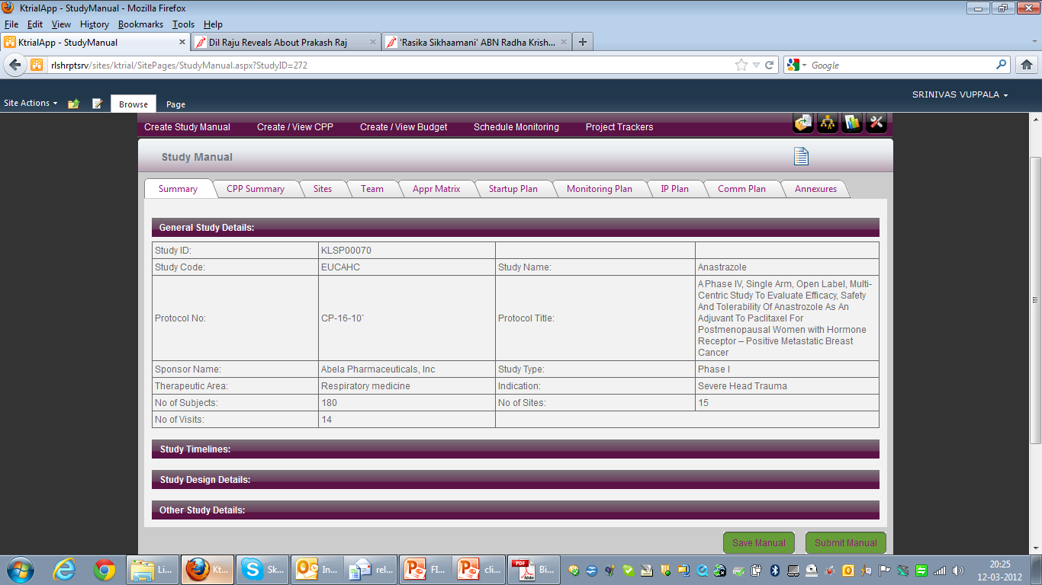
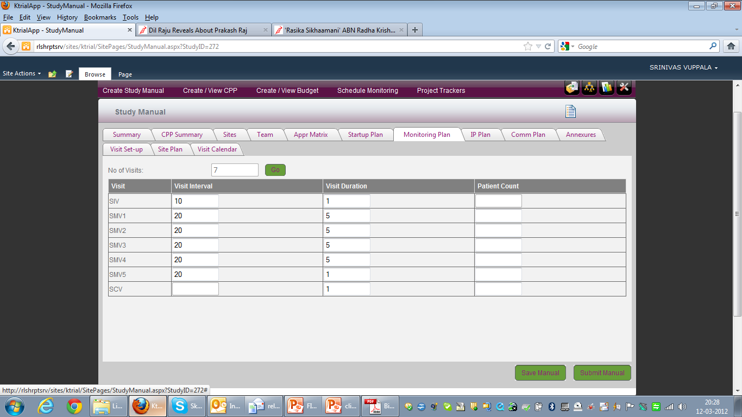
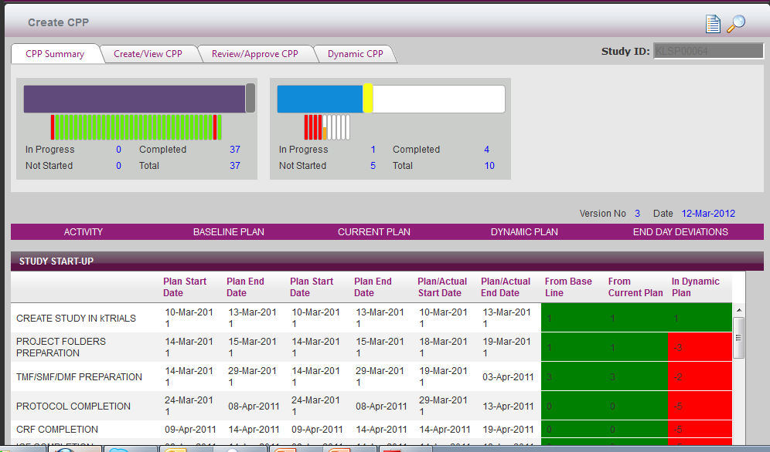
Sample Screens – Study and Clinical Project Plan

Slide 15
2. Study Conduct Monitoring Visits

Slide 16
Step 2.1: Study Tracking
2.1.1 Recruitment Planning & Tracking
Central Apps – CRO (C₁)
Field Apps – Site (S1)
Dashboard
Study
Visits
Docs
Query
Dashboard
Study
Visits
Docs
Query
Study Tracking
Monitoring Plan
Visit Schedule
Visit Reports
Site Issues
Study Conduct
Monitoring Plan
Monitoring Schedule
Site Issues
Sites Screened Random Enrolled
Screened Randomized Enrolled
S-1 10 5 5
`10 5 5
S-2 13 5 3
Track Enrollment
Track Recruitment
Plan recruitment
Recruit patients
Enroll Patients
S₁
S₂
S_{n}

Slide 17
Step 2.2: Study Tracking
2.1.2 Safety & Compliance Tracking
Central Apps – CRO (C₁)
Field Apps – Site (S1)
Dashboard
Study
Visits
Docs
Query
Dashboard
Study
Visits
Docs
Query
Study Tracking
Monitoring Plan
Visit Schedule
Visit Reports
Site Issues
Study Conduct
Monitoring Plan
Monitoring Schedule
Site Issues
Alerts
Sites AE/SAE PD/PV Others
Patient AE SAE
Patient PD PV
S-1 10 5 6
P1 5 1
P1 5 1
S-2 13 6 5
P2 3 1
P2 3 1
Safety Alerts
Compliance Alerts
Conduct Trial
Safety Reporting
Track Compliance
S₁
S₂
S_{n}

Slide 18
Step 2.1: Study Tracking
2.1.3 Investigator Payments
Central Apps – CRO (C₁)
Field Apps – Site (S1)
Dashboard
Study
Visits
Docs
Query
Dashboard
Study
Visits
Docs
Query
Study Tracking
Monitoring Plan
Visit Schedule
Visit Reports
Site Issues
Study Conduct
Monitoring Plan
Monitoring Schedule
Site Issues
Alerts
Payment Requests
Sites Payment Due date Payment Status
Request ID
S-1 04-Mar-2012 Overdue
Description
S-2 05 -Mar-2012 Paid
Due date
S-3 10-Mar-2012 Not Paid
Payment Workflow
Plan Site Payments
Payment Requests
Payment Tracking
S₁
S₂
S_{n}

Slide 19
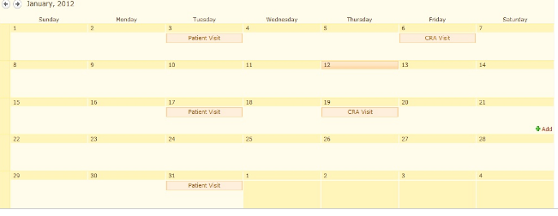
Step 2.1: Study Tracking
2.1.5 Patient Visits
Central Apps – CRO (C₁)
Field Apps – Site (S1)
Dashboard
Study
Visits
Docs
Query
Dashboard
Study
Visits
Docs
Query
Study Tracking
Monitoring Plan
Visit Schedule
Visit Reports
Site Issues
Study Conduct
Monitoring Plan
Monitoring Schedule
Site Issues
Site 1
Select Patient
Patient Planned Date Actual Date
P-1 04-Mar-2012 05-Mar-2012
Screening
P-2 05 -Mar-2012 07-Mar-2012
Visit 1
Site 2
Track Patient Visits
Schedule Patient visits
Record deviations
S₁
S₂
S_{n}

Slide 20
Step 2.1: Study Tracking
2.1.6 IP Shipments
Central Apps – CRO (C₁)
Field Apps – Site (S1)
Dashboard
Study
Visits
Docs
Query
Dashboard
Study
Visits
Docs
Query
Study Tracking
Monitoring Plan
Visit Schedule
Visit Reports
Site Issues
Study Conduct
Monitoring Plan
Monitoring Schedule
Site Issues
Alerts
Shipment Requests
Sites Shipment Due date Status
Request ID
S-1 04-Mar-2012 Pending
Shipment Det.
S-2 05 -Mar-2012 Completed
S-3 10-Mar-2012 Completed
Track IP shipments
IP Shipments
Shipment Requests
S₁
S₂
S_{n}

Slide 21
Step 2.2: Trial Manager Creates Monitoring Plan and Sync up with Sites
Central Apps – CRO (C₁)
Field Apps – Site (S1)
Dashboard
Study
Visits
Docs
Query
Dashboard
Study
Visits
Docs
Query
Study Tracking
Monitoring Plan
Visit Schedule
Visit Reports
Site Issues
Study Conduct
Monitoring Plan
Monitoring Schedule
Site Issues
Site SIV SMV1 SMV2 SMV3
S-1 10-3 -12 21-4-13 15-4-12 10-5-12
SMV1
S-2 25-3 -12 02-4-14 10-4-12 07-5-12
SMV2
Site Request Proposed Date
Request Proposed Date
S1 SIV Date Change 12-3-2012
SIV Date Change 12-3-2012
Plan
Create Monitoring Plan
Monitoring Plan Workflow
Publish Monitoring Plan
Plan Changes
Review Monitoring Plan
Request Changes
S₁
S₂
S_{n}

Slide 22

Step 2.3: CRA Schedules Monitoring Visits and Sync up with Sites
Central Apps – CRO (C₁)
Field Apps – Site (S1)
Dashboard
Study
Visits
Docs
Query
Dashboard
Study
Visits
Docs
Query
Study Tracking
Monitoring Plan
Visit Schedule
Visit Reports
Site Issues
Study Conduct
Monitoring Plan
Monitoring Schedule
Site Issues
SMV – S1
CRA visit
SMV – S2
SMV – S2
CRA Visit
CRA Visit
Track study Progress at site
Schedule Visits
Publish Monitoring calendar
Review Schedule
Set up Appointments
Req schedule changes
S₁
S₂
S_{n}

Slide 23
Step 2.4: CRA creates Monitoring reports, record site issues & Sync up with Sites
Central Apps – CRO (C₁)
Field Apps – Site (S1)
Dashboard
Study
Visits
Docs
Query
Dashboard
Dashboard
Study
Study
Visits
Visits
Docs
Docs
Query
Query
Study Tracking
Monitoring Plan
Visit Schedule
Visit Reports
Site Issues
Study Conduct
Monitoring Plan
Monitoring Schedule
Site Issues
Visit Report
Issue Description Due date Status
S1_SMV1_Rep v1.0 Review Pending
Source docs Incomplete 5-03-2012 Completed
S2_SMV1_Rep v1.0 Rejected
S3_SMV1_Rep v1.1 Approved
Source data errors 6-03-2012 Ongoing
Site issues
Issue Description Due date Status
S1 Source docs incomplete 5-03-2012
S1 Source data Errors 6-03-2012
S2 Subject log Incomplete 10-03-2012
Create Monitoring Report
Monitoring Report Workflow
Publish Monitoring Report
Record Visit Findings
Issue Closure
Inform CRA
S₁
S₂
S_{n}

Slide 24
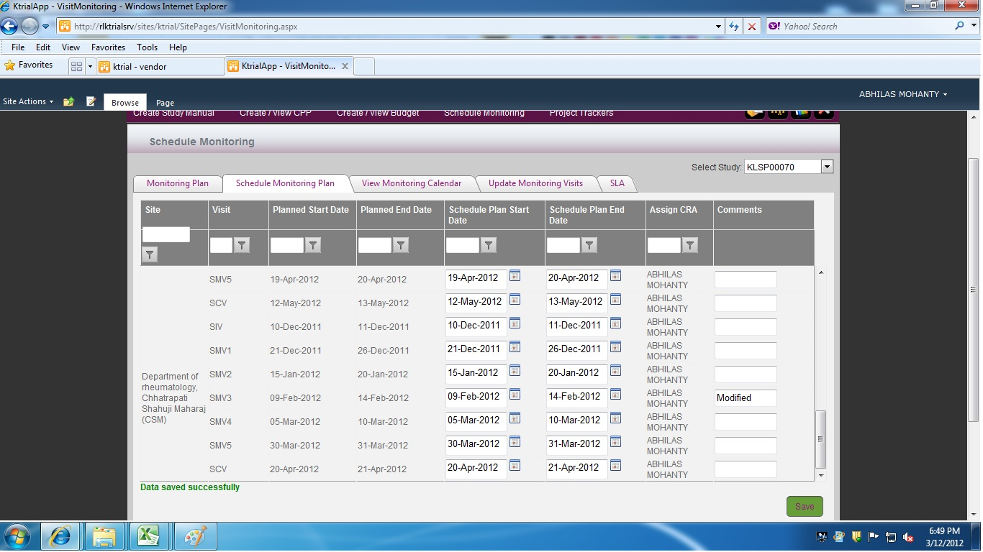
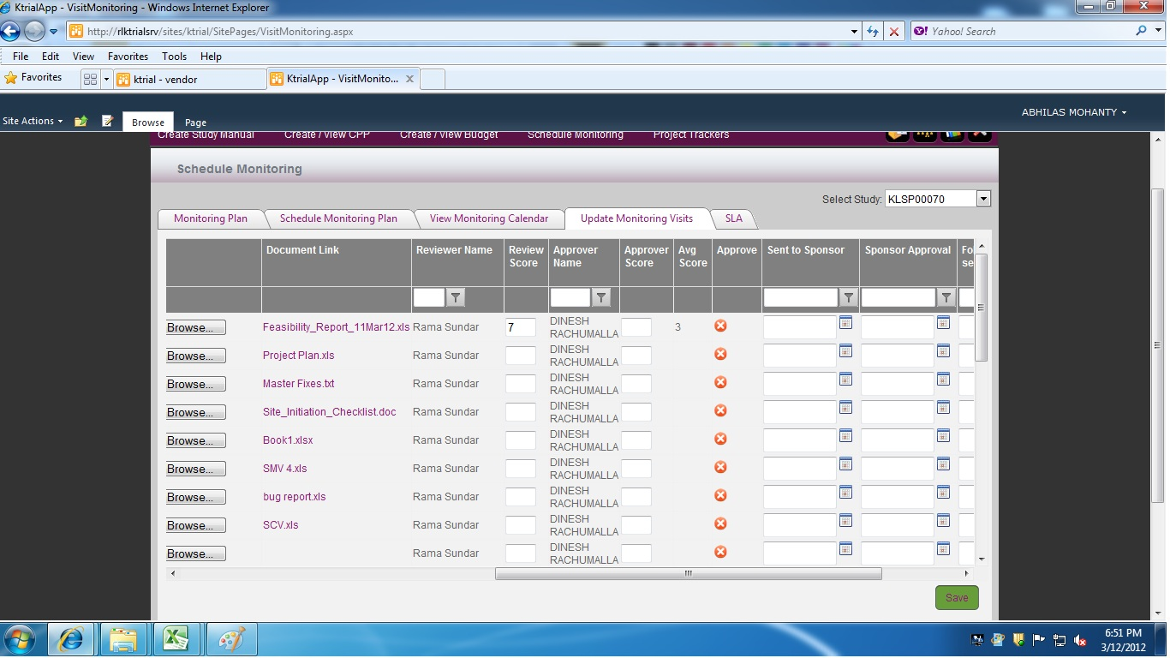
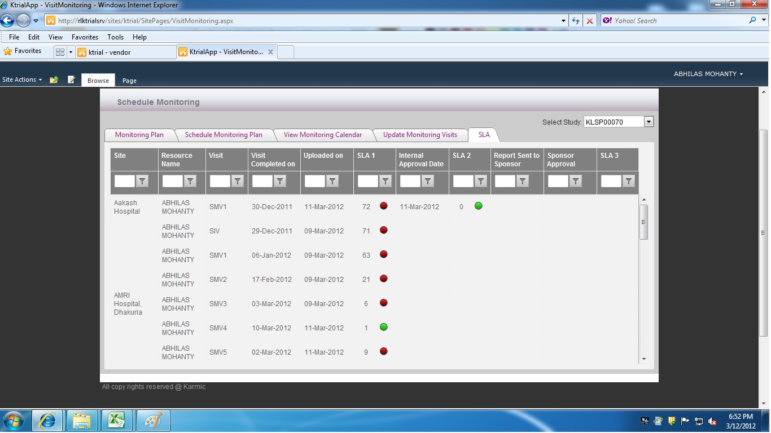
Sample Screens – Schedule Monitoring and SLAs

Slide 25
3. Study Documents

Slide 26
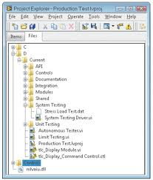
Step 3.1: Trial Manager Maintains TMF sync up with sites SMF
Central Apps – CRO (C₁)
Field Apps – Site (S1)
Dashboard
Study
Visits
Docs
Query
Dashboard
Study
Visits
Docs
Query
eTMF
Essential Docs
eSMF
Essential Docs
TMF Updated 11-03-2012
TMF Updated 11-03-2012
SMF Status Reviewed on
S-1 Review Complete 10-03-2012
S-2 Pending docs 10-03-2012
Review SMF
Request Doc
Update TMF
Upload SMF docs
Update SMF Docs
S₁
S₂
S_{n}

Slide 27
Step 3.2: Trial manager Tracks essential docs submitted by site
Central Apps – CRO (C₁)
Field Apps – Site (S1)
Dashboard
Study
Visits
Docs
Query
Dashboard
Study
Visits
Docs
Query
Essential Docs
eTMF
Essential Docs
eSMF
Site 1
Request Assigned By Assigned Date Due Date Upload Doc
ICF Log
EC Tracker Debarati 27 –Jan-2012 7-Mae-2012
CRF Tracker
Temperature Log
EC Tracker Send Req
Site 2
Document Workflow
Request Changes
Track essential docs
Consolidate Documents from S1, s2….
Upload Study docs
Update Docs
S₁
S₂
S_{n}

Slide 28
4.Requests

Slide 29
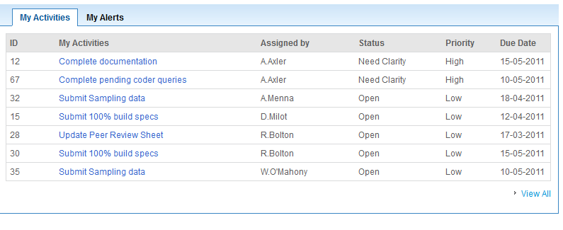
Step 4.1: Trial Manager sends Request/Tasks to Sites and tracks Closure
Central Apps – CRO (C₁)
Field Apps – Site (S1)
Dashboard
Study
Visits
Docs
Query
Dashboard
Study
Visits
Docs
Query
Request Name Study Request type AS RS PS Due Date
EC 27 Jan CS001 EC Tracker 2 1 1 27-Mar-2012
SS 27 Jan CS002 Site Startup Doc 2 0 2 27-Jan-2012
Report Site issues
Tasks/Request
Track Closure
Complete Tasks
Respond to Request
S₁
S₂
S_{n}

Slide 30
Next Steps - DART
Discuss - Applicable use case for your business
  Application can used with specific use-case
Assessment and Gap-analysis
Review scope
Transformation /Delivery

Slide 31
Appendix

Slide 32
Trial Definition Scenario
Step 1 | System | Description | Priority
Create a Trial | CTMS | User creates a trial master with all sites
 |  | Approval authority approves
Sync up with sites | CTMS | Send “Trialdef” to all selected sites
Receive site | STMS | Receive “Trialdef” - only general data
Acknowledge site | STSM | Generates acknowledgement of trial data
Flag Site | CTMS | CTMS records site creation in STMS for trial
Receive site | STMS | Add resources to “new site”

Slide 33
Trial Visit Scenario
Step 1 | System | Description | Priority
Create monitoring visit plan View plan calendar | CTMS | User creates a trial master with all sites
Update resources for each site / visit | CTMS | Update CRA resources
CRA Calendar | CTMS | CRA sees all his visit calendar
CRA views site readiness template and Schedules Visit and sends plan to site | CTMS | Exports plan to STMS
CRC views Visit plan and provides feedback/update | STSM | Sync up
CRC updates readiness checklist | STMS | Sync up
CRA makes visit and prepare reports/ creates actions | CTMS | Sync up
CRC views report /actions update actions | STMS | Sync Up

Slide 34
Trial Document Scenario
Step 1 | System | Description | Priority
Create a Trial (TMF) Folders / site trail folders(SMF) | CTMS | System sets up expected documents and document library
Sync up with sites | STMS | Creates Document library
System creates Alerts for document activities | CTMS/STMS
Document Scan and Upload documents | STSM | Sync up with CTMS
System names doc naming, version control and attach meta data, puts in folder | CTMS
System flags up non compliance,Dashboard | CTMS/STMS | Sync up with STMS
Document workflow/ E/Digi-signature | CTMS/STMS | Sync up | TBC

Slide 35
Trial Request Scenario
Step 1 | System | Description | Priority
PM/CRA writes a query – send to Sites - Missing documents, Query on Missing Actions, readiness for Visits, Query on Investigation, subject etc.. ( with Annotations /attachments) | CTMS | System syncs up actions
CRC Records Response (add attachments) | STMS | Sync up
CRA / PM review and Accept or ask more clarifications | CTMS | Sync up
CRC Responses | STMS | Sync up with CTMS
Action alerts and Dashboard | CTMS/STMS | Sync up

Slide 36
Thank You

